Slide 1
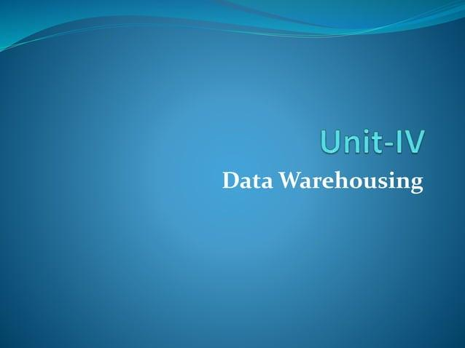

Slide 2
OLAP
OLAP stands for Online Analytical Processing. It is a technology used to help people analyze and understand large amounts of data in a fast and flexible way.
Think of OLAP like a giant spreadsheet or database, but instead of just showing numbers, it helps you see patterns, trends, and relationships in the data. It allows you to view data from different angles and ask different questions.
For example, if you have a lot of sales data, OLAP could help you answer questions like:
How much did we sell in January?
Which products are selling the most in each region?
What were our sales last year compared to this year?
To make this easy, OLAP organizes data into a cube (like a 3D chart), where you can look at different layers of data—such as time (months, years), product categories, or sales regions—by rotating the cube and changing views.

Slide 3
OLAP Server
OLAP Servers
An OLAP server is a platform where data is stored, organized, and processed for analytical purposes. There are two types of OLAP servers:
MOLAP (Multidimensional OLAP): This type stores data in a multidimensional cube format. It allows for fast data retrieval and is often used for complex analyses.
Example: Microsoft SQL Server Analysis Services (SSAS) is a MOLAP server that stores data in cubes for faster analysis.
ROLAP (Relational OLAP): This type uses relational databases to store data. ROLAP doesn't create cubes, but it queries the data directly from relational databases when needed.
Example: Oracle OLAP is an example of a ROLAP tool. It uses relational databases to perform OLAP queries.
HOLAP (Hybrid OLAP): Combines both MOLAP and ROLAP, using cubes for summary data and relational databases for detailed data.
Example: Microsoft SSAS can operate in both MOLAP and HOLAP modes.

Slide 4
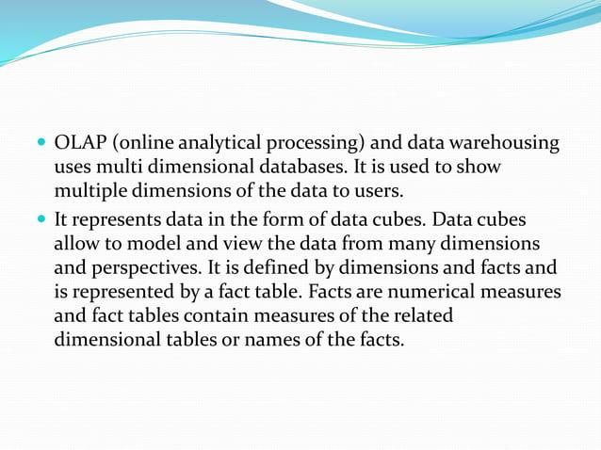

Slide 5
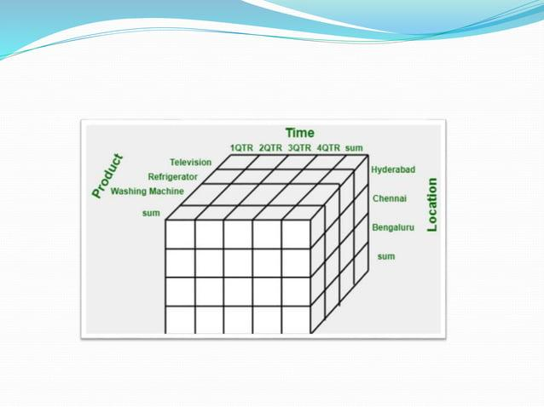

Slide 6
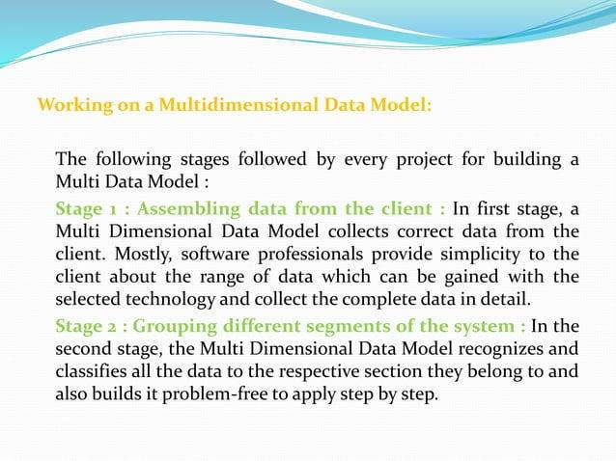

Slide 7
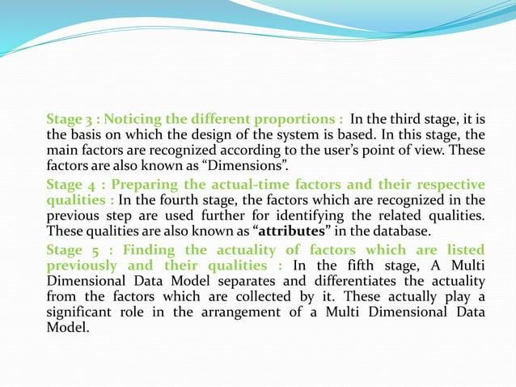

Slide 8


Slide 9
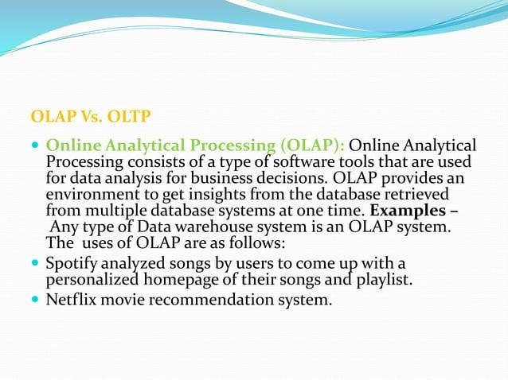

Slide 10
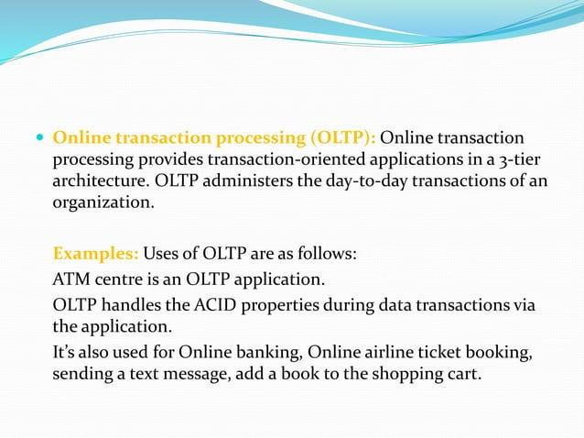

Slide 11
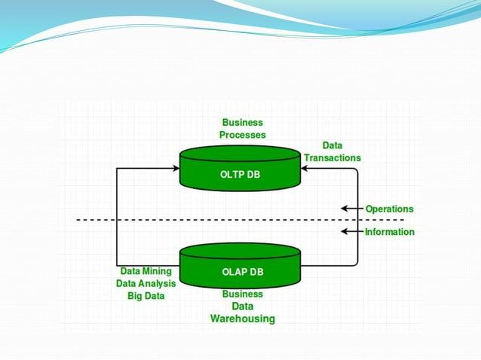

Slide 12
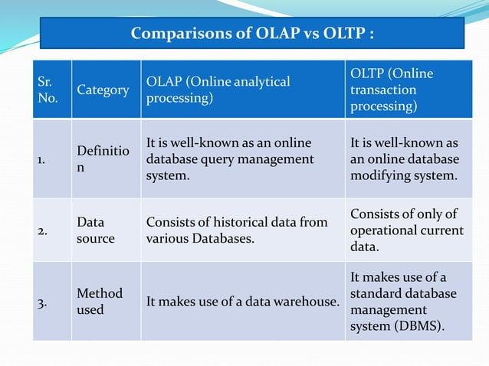

Slide 13
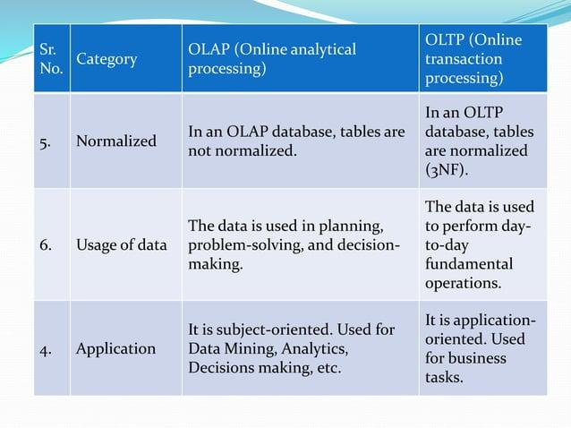

Slide 14
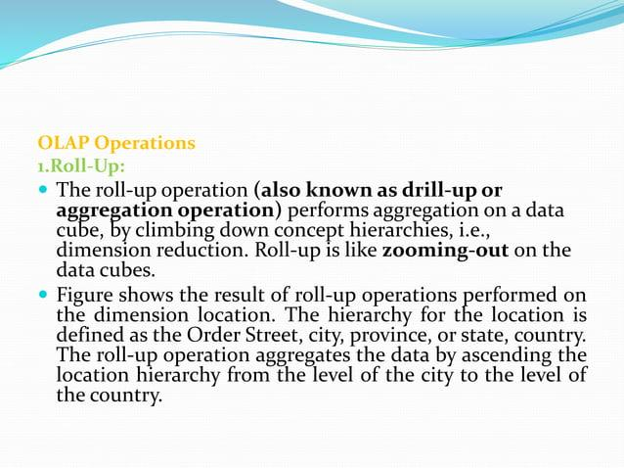

Slide 15
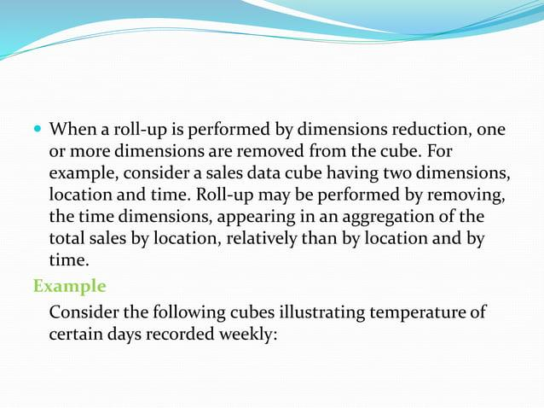

Slide 16
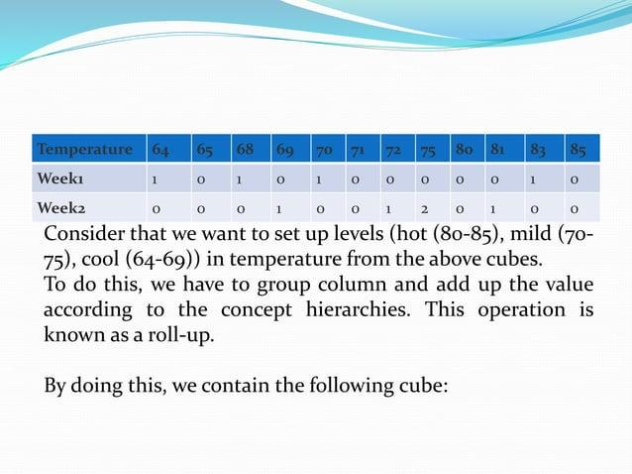

Slide 17
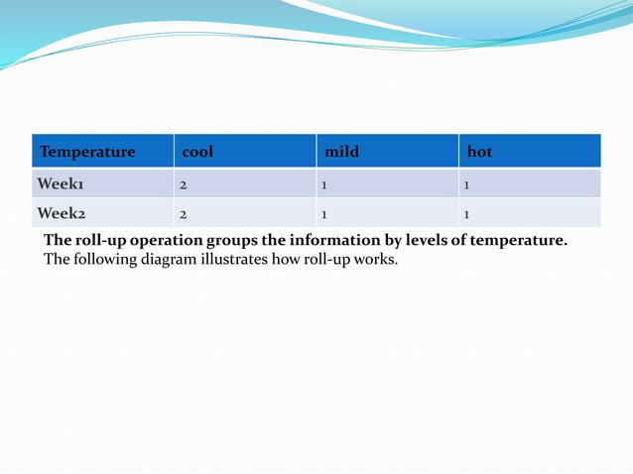

Slide 18
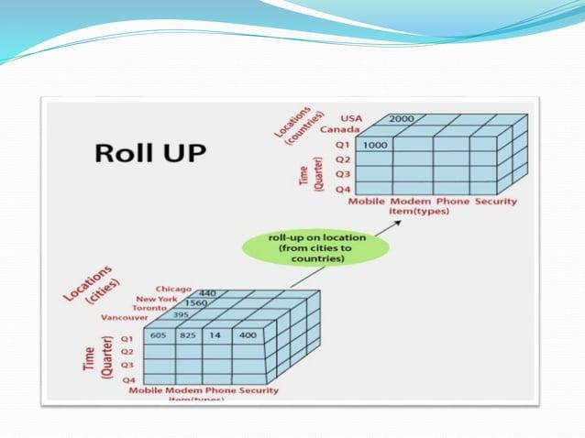

Slide 19
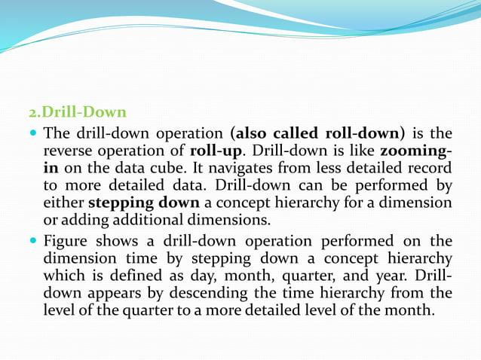

Slide 20
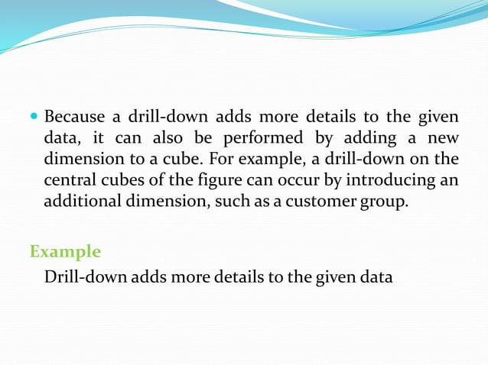

Slide 21
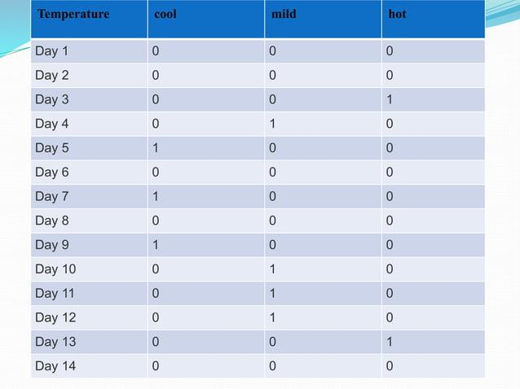

Slide 22
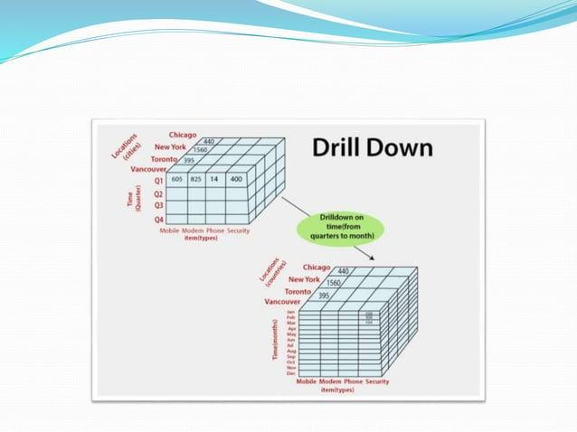

Slide 23


Slide 24
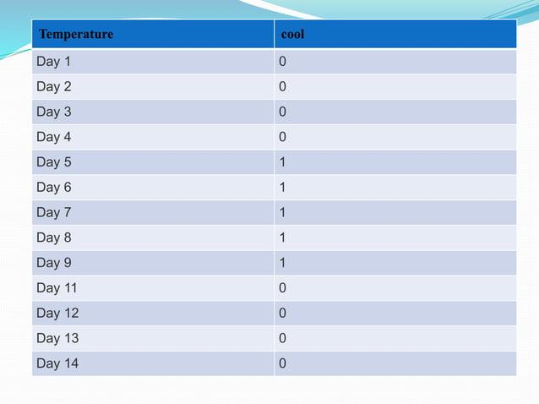

Slide 25
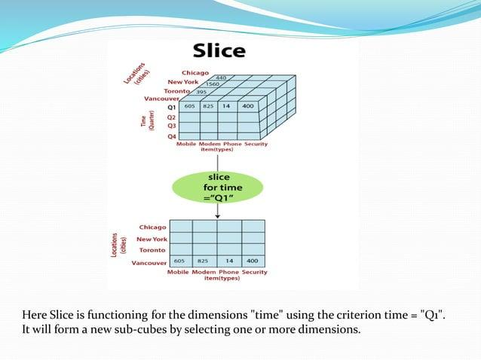

Slide 26
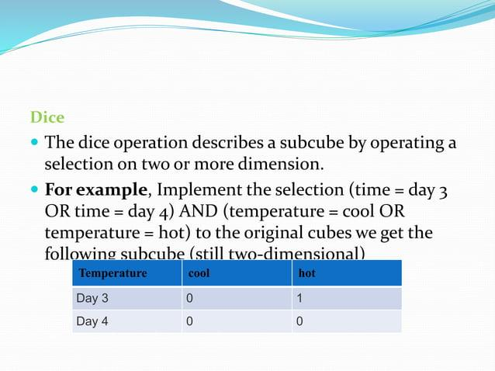

Slide 27
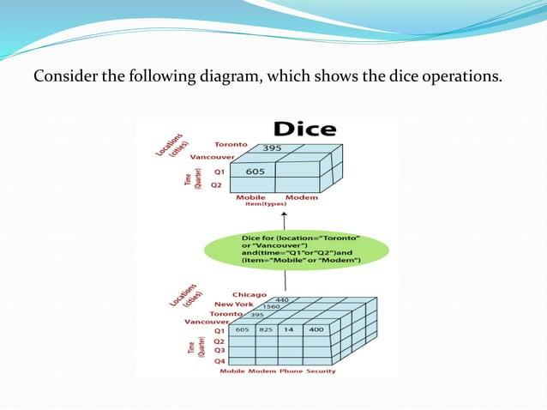

Slide 28
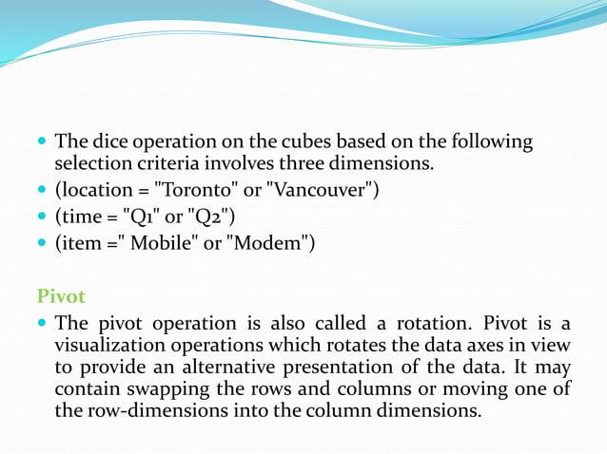

Slide 29
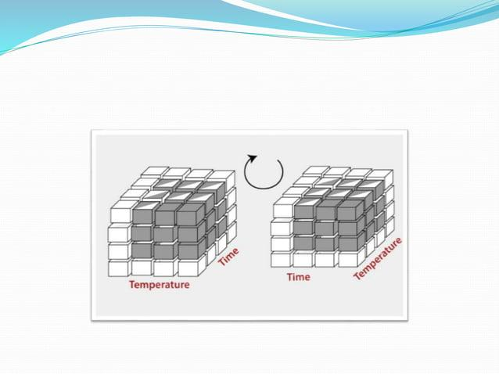

Slide 30
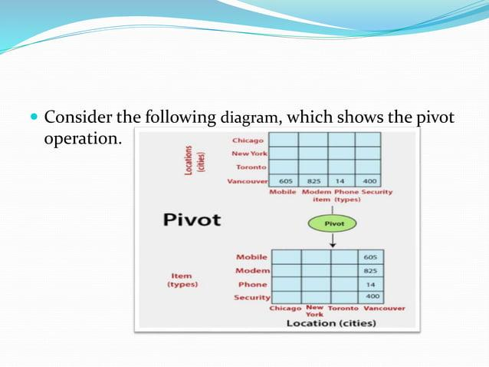

Slide 31
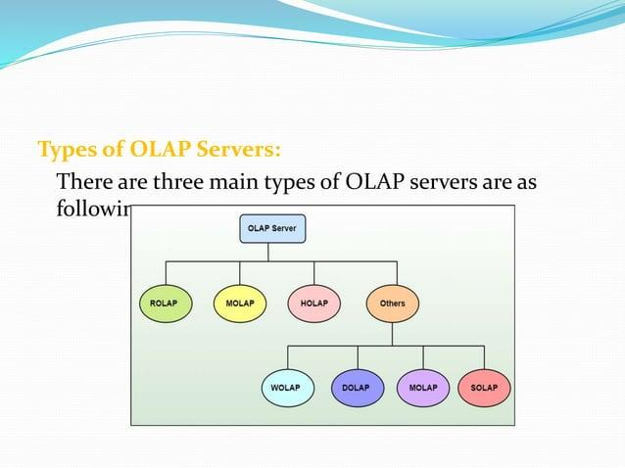

Slide 32
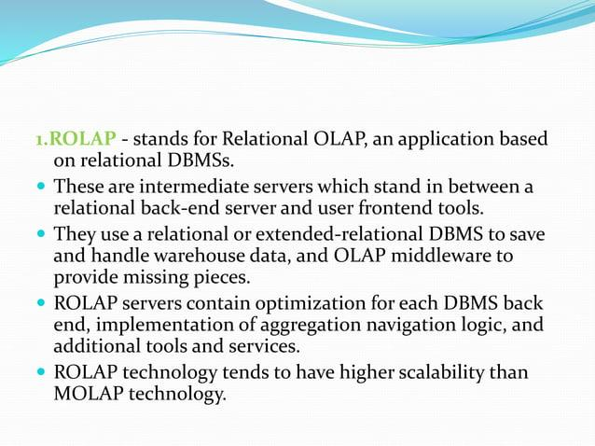

Slide 33
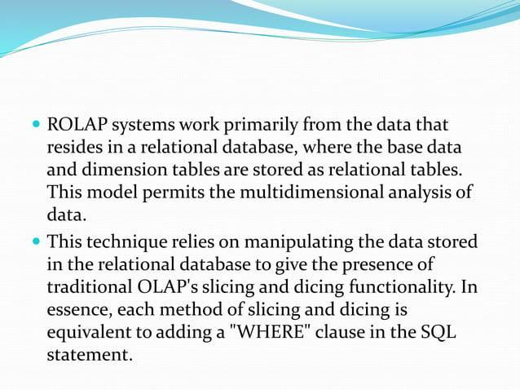

Slide 34
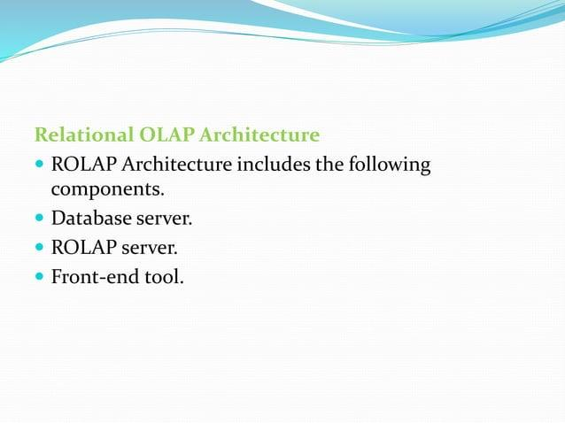

Slide 35
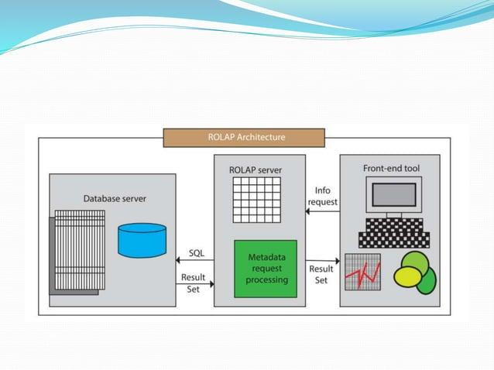

Slide 36
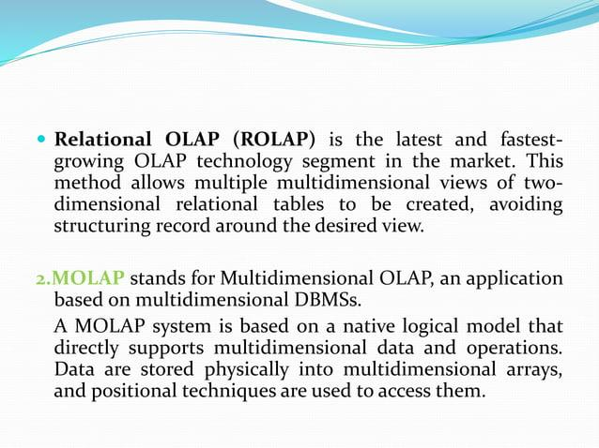

Slide 37
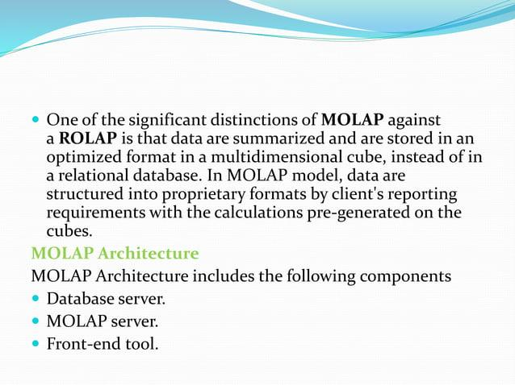

Slide 38
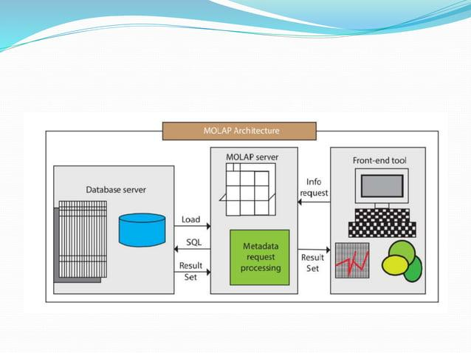

Slide 39
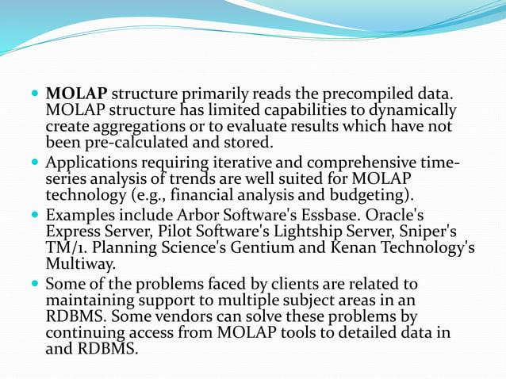

Slide 40
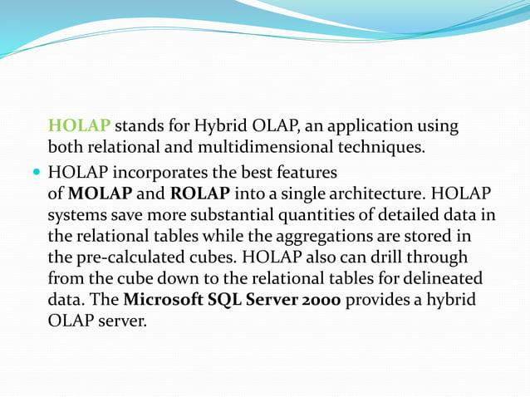

Slide 41
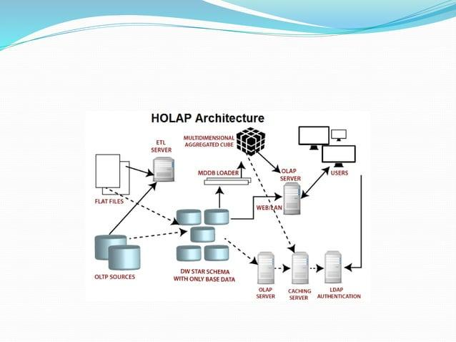

Slide 42
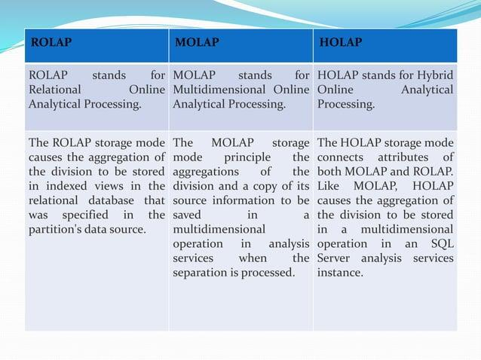

Slide 43
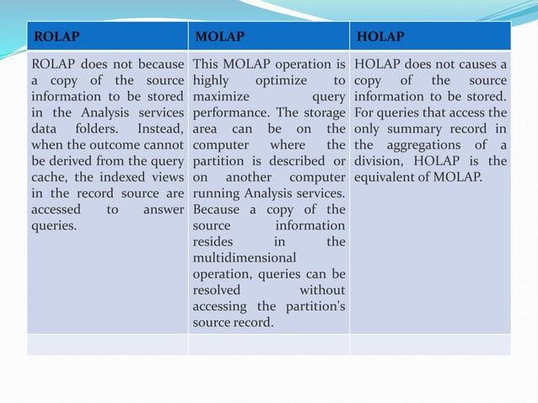

Slide 44
OLAP Tools and Technologies
OLAP Tools
These are software applications that help users interact with OLAP servers and perform data analysis. OLAP tools provide an easy interface for creating reports, visualizing trends, and answering business questions.
1. Microsoft Power BI: A popular BI tool that allows users to analyze data and create interactive reports. Power BI can connect to various data sources, including OLAP cubes, and provides a simple drag-and-drop interface.
Example: A retail company can use Power BI to analyze sales data stored in an OLAP cube and create dashboards showing sales trends by region, product, or time.

Slide 45
OLAP Tools and Technologies
2. Tableau: Another powerful data visualization tool that allows users to connect to OLAP data sources. Tableau makes it easy to create interactive charts, graphs, and dashboards.
Example: A company can use Tableau to visualize customer behavior trends across different product categories using data from OLAP cubes.
3.QlikView: This tool helps users to visualize and explore data by connecting to OLAP and relational databases. It offers a unique associative data model that enables users to explore data from different angles.
Example: A manufacturing company can use QlikView to explore production performance data stored in an OLAP system and quickly identify bottlenecks or inefficiencies.

Slide 46
OLAP Tools and Technologies
What is Microsoft Power BI?
Microsoft Power BI is a tool that helps people look at and understand data in a simple way. It turns your raw data into interactive charts, graphs, and reports so that anyone can make smart decisions quickly. Power BI allows you to connect to different data sources (like databases or Excel files) and analyze that data visually.
Key Features of Power BI:
Interactive Dashboards: You can create dashboards where you can click and explore your data in real-time.
Easy Visualization: You can create charts, graphs, maps, and more without needing to know complex programming.
Data Sharing: You can share reports with others, so teams can collaborate and make better decisions.
Real-Time Analysis: Power BI allows you to track and monitor your data live as it changes.

Slide 47
OLAP Tools and Technologies
How Power BI Works:
Connect to Data: You connect Power BI to your data source (like an Excel file, a database, or an OLAP cube).
Transform Data: Power BI has tools to clean and prepare the data for analysis.
Visualize Data: You can then create reports and dashboards using various charts like bar charts, pie charts, and line graphs.
Publish and Share: Once you create your report, you can publish it and share it with others.
Example of OLAP Analysis Using Power BI
Let’s say you have sales data stored in an OLAP cube, and you want to visualize it using Power BI. Here’s how you might set it up in very simple steps:

Slide 48
OLAP Tools and Technologies
Steps:
Connect Power BI to Your OLAP Cube:
Open Power BI.
Click on Get Data.
Select Analysis Services (for connecting to OLAP cubes).
Enter the server name and database to connect to your OLAP cube.
Create a Simple OLAP Query:
After connecting, you can see your data model in Power BI.
Let's say you want to analyze Sales by Region and Product.
Here’s a simple example of how to do it with DAX (Data Analysis Expressions), the language used in Power BI for creating calculations:

Slide 49
OLAP Tools and Technologies
Steps:
Connect Power BI to Your OLAP Cube:
Open Power BI.
Click on Get Data.
Select Analysis Services (for connecting to OLAP cubes).
Enter the server name and database to connect to your OLAP cube.
Create a Simple OLAP Query:
After connecting, you can see your data model in Power BI.
Let's say you want to analyze Sales by Region and Product.
Here’s a simple example of how to do it with DAX (Data Analysis Expressions), the language used in Power BI for creating calculations:
Total Sales = SUM('Sales'[SalesAmount])

Slide 50
OLAP Tools and Technologies
This formula calculates the total sales amount from your sales data.
Add Visualizations:
Drag and drop fields like Region, Product, and Sales Amount into a report.
Choose a bar chart or pie chart to visualize sales by region.
Slice and Dice the Data:
You can use slicers to filter the data by time periods (like months or years) or other categories (like product types).
Publish and Share:
Once you have your report set up, you can publish it to the Power BI service, where others in your organization can view and interact with it.

Slide 51
OLAP Tools and Technologies
This formula calculates the total sales amount from your sales data.
Add Visualizations:
Drag and drop fields like Region, Product, and Sales Amount into a report.
Choose a bar chart or pie chart to visualize sales by region.
Slice and Dice the Data:
You can use slicers to filter the data by time periods (like months or years) or other categories (like product types).
Publish and Share:
Once you have your report set up, you can publish it to the Power BI service, where others in your organization can view and interact with it.

Slide 52
OLAP Tools and Technologies
Sample Code (DAX Example):
Let’s say we have an OLAP cube that stores SalesData with columns like Region, Product, and SalesAmount.
Now, you want to calculate the total sales by Region and Product. Here's how you can write a simple DAX formula to calculate the total sales:
Total Sales = SUM('SalesData'[SalesAmount])
You could then create a bar chart in Power BI:
Drag Region to the Axis field.
Drag Total Sales to the Values field.
You’ll see the total sales for each region.

Slide 53
OLAP Tools and Technologies
Example of an OLAP Query in Power BI (using MDX):
If you’re working with an OLAP cube, you might use MDX (Multidimensional Expressions) queries to extract data. However, in Power BI, you often don’t need to write MDX directly, because Power BI automatically translates your actions into the necessary queries. But if you're querying an OLAP cube, it would look something like this:
SELECT
[Measures].[SalesAmount] ON COLUMNS,
[Product].[Category] ON ROWS
FROM [SalesCube]
WHERE ([Region].[North America])

Slide 54
OLAP Tools and Technologies
This MDX query asks for the SalesAmount for different Product Categories in the North America region.
Conclusion:
Power BI is a great tool for exploring and visualizing data. It connects easily to OLAP cubes and allows you to create interactive dashboards with just a few clicks. You don't need to be an expert in coding or data science to use Power BI — it’s designed to be user-friendly and accessible for anyone.
Key Takeaways:
Power BI helps you analyze and visualize your data.
You can connect Power BI to OLAP cubes, databases, or Excel files.
It provides easy-to-use tools for creating interactive charts and reports.
DAX and MDX are languages used for advanced calculations and queries in Power BI, but you don't need to know them to get started.

Slide 55
OLAP Tools and Technologies
What is OLAP?
OLAP stands for Online Analytical Processing, a technique used in data analysis to quickly answer complex queries involving large datasets. It allows users to:
Summarize data into cubes.
Perform multi-dimensional analysis (slicing, dicing, rolling up, and drilling down).
Aggregate data efficiently.
📊 How Tableau Uses OLAP
Tableau uses OLAP concepts for:
Data visualization and exploration: Connecting to OLAP cubes (like Microsoft SQL Server Analysis Services).
Multi-dimensional analysis: Allows users to slice and dice data with drag-and-drop features.
Aggregation and filtering: Easy aggregation (SUM, AVG, MIN, MAX) across multiple dimensions.

Slide 56
OLAP Tools and Technologies
🛠️ OLAP Cube Example – Python Simulation
Since Tableau itself doesn't involve direct coding, I'll show how OLAP-like data analysis works using Python with Pandas and NumPy. You can load similar data into Tableau for visualization.
🐍 1. OLAP Simulation with Python
We'll create a small OLAP cube with sales data and perform slicing, dicing, and aggregation.

Slide 57
OLAP Tools and Technologies
import pandas as pd
import numpy as np
# Sample data
data = {
"Region": ["North", "North", "South", "South", "East", "East", "West", "West"],
"Product": ["A", "B", "A", "B", "A", "B", "A", "B"],
"Month": ["Jan", "Jan", "Feb", "Feb", "Mar", "Mar", "Apr", "Apr"],
"Sales": [100, 200, 150, 250, 130, 220, 170, 300]
}
# Create DataFrame
df = pd.DataFrame(data)
# Print results
print("\nSlice (North region):")
print(slice_north)
print("\nDice (North region, Product A):")
print(dice)
print("\nRoll-up (Total Sales by Region):")
print(rollup)
print("\nDrill-down (Sales by Region and Product):")
print(drilldown)
# Simulate OLAP operations:
# 1. Slice: Filter for 'North' region
slice_north = df[df['Region'] == 'North']
# 2. Dice: Filter for 'North' and 'Product A'
dice = df[(df['Region'] == 'North') & (df['Product'] == 'A')]
# 3. Roll-up (aggregate): Group by region and sum sales
rollup = df.groupby('Region')['Sales'].sum().reset_index()
# 4. Drill-down: Group by region and product
drilldown = df.groupby(['Region', 'Product'])['Sales'].sum().reset_index()

Slide 58
OLAP Tools and Technologies
📈 2. Tableau Visualization
If you were to visualize this in Tableau:
Slice: Filter by Region = North.
Dice: Filter by Region = North and Product = A.
Roll-up: Create a SUM aggregation by region.
Drill-down: Add a hierarchical view by Region → Product.
🚀 Key Takeaway
OLAP cubes in Tableau allow for complex, multi-dimensional data analysis.
Using Python, you can simulate basic OLAP operations before loading the data into Tableau for rich visualizations.
Tableau’s OLAP capabilities make it easy to slice, dice, roll up, and drill down data visually without coding.

Slide 59
OLAP Tools and Technologies
💡 What is QlikView?
QlikView is a Business Intelligence (BI) tool used for data visualization and analysis. It allows you to:
Load and manipulate large datasets.
Perform OLAP-style multi-dimensional analysis.
Use Associative Data Modeling, which links data dynamically for easy exploration.
📊 How QlikView Uses OLAP
QlikView offers OLAP functionalities through:
Associative Data Model: Automatically connects related data fields.
Drill-down and Roll-up: Users can zoom in and out on hierarchical data.
Slicing and Dicing: Filter and explore subsets of data interactively.
Aggregation: Sum, Average, Min, Max, etc., across dimensions.

Slide 60
OLAP Tools and Technologies
🛠️ OLAP Example with QlikView – Simple Code
In QlikView, you define the data model using scripts, then build visualizations on top of it.
🐍 1. Sample Data and OLAP Script
Imagine you have sales data stored in a CSV file (sales_data.csv) with the following columns:
Region, Product, Month, Sales
North, A, Jan, 100
North, B, Jan, 200
South, A, Feb, 150
South, B, Feb, 250
East, A, Mar, 130
East, B, Mar, 220
West, A, Apr, 170
West, B, Apr, 300

Slide 61
OLAP Tools and Technologies
🛠️ 2. QlikView Script to Load and Perform OLAP Operations
Here’s how you can load and analyze the data using QlikView’s Script Editor:
✅ Step 1: Open QlikView → Go to Edit Script → Paste the following code.
// Load data from CSV file
SalesData:
LOAD
Region,
Product,
Month,
Sales
FROM
sales_data.csv
(txt, codepage is 1252, embedded labels, delimiter is ',', msq);
// Slicing: Filter North region (Create a filter in the dashboard)
NorthSales:
LOAD
Region,
Product,
Month,
Sales
RESIDENT SalesData
WHERE Region = 'North';
// Dicing: Filter North region and Product A
NorthProductA:
LOAD
Region,
Product,
Month,
Sales
RESIDENT SalesData
WHERE Region = 'North' AND Product = 'A';
// Roll-up: Sum Sales by Region
Rollup:
LOAD
Region,
SUM(Sales) AS TotalSales
RESIDENT SalesData
GROUP BY Region;
// Drill-down: Sales by Region and Product
Drilldown:
LOAD
Region,
Product,
SUM(Sales) AS SalesByProduct
RESIDENT SalesData
GROUP BY Region, Product;

Slide 62
OLAP Tools and Technologies
📈 3. OLAP Operations in QlikView
Once the script is loaded:
Go to Sheet Editor.
Create charts to visualize OLAP operations:
Slice: Use a filter pane to show only North region data.
Dice: Use multiple filters (Region = North and Product = A).
Roll-up: Create a bar chart with Region on the X-axis and SUM(Sales) as the measure.
Drill-down: Use a hierarchical dimension (Region → Product) for detailed exploration.
🚀 Key Takeaway
QlikView provides OLAP capabilities by allowing slicing, dicing, roll-up, and drill-down operations on large datasets.
Script-based data loading and filtering enables multi-dimensional analysis.
Associative data model makes filtering and exploring data highly intuitive and fast.

Slide 63
OLAP Tools and Technologies
📈 ✅ Applications of OLAP in Business Decision-Making (Easy Language)
OLAP (Online Analytical Processing) helps businesses make better decisions by analyzing large amounts of data quickly and efficiently. Here are some common real-life applications:
📊 1. Sales and Marketing Analysis
Track sales performance by region, product, or time period.
Identify top-selling products and underperforming ones.
Plan marketing campaigns by analyzing customer behavior patterns. ✅ Example: A company uses OLAP to check which product sells the most in different regions, helping them target promotions effectively.

Slide 64
OLAP Tools and Technologies
💰 2. Financial Reporting and Budgeting
Summarize and analyze revenue, expenses, and profit across departments.
Create financial forecasts by observing trends.
Identify areas of unnecessary spending. ✅ Example: A finance team uses OLAP to compare monthly expenses across branches and adjust the budget accordingly.
🛒 3. Inventory and Supply Chain Management
Monitor stock levels in different locations.
Analyze supply and demand patterns.
Optimize inventory levels by predicting future needs. ✅ Example: A retail company uses OLAP to see which products are running low and orders more before they run out.

Slide 65
OLAP Tools and Technologies
👥 4. Customer Relationship Management (CRM)
Analyze customer preferences and buying habits.
Identify loyal customers and create personalized offers.
Improve customer retention by addressing issues early. ✅ Example: An e-commerce company uses OLAP to find customers who frequently abandon their carts and sends them discount offers.
⚙️ 5. Human Resources (HR) Analysis
Monitor employee performance and productivity.
Analyze absenteeism trends.
Plan for workforce expansion or downsizing based on data. ✅ Example: A company uses OLAP to check which departments have the highest turnover rate and take corrective actions.

Slide 66
OLAP Tools and Technologies
🌐 6. Healthcare and Insurance
Analyze patient records for treatment effectiveness.
Detect fraudulent claims in insurance.
Identify trends in diseases and plan resources accordingly. ✅ Example: A hospital uses OLAP to track which treatments have the highest success rates.
🚀 Key Takeaway
OLAP helps businesses:
Make faster, data-driven decisions.
Identify trends and patterns to gain insights.
Improve efficiency by analyzing multi-dimensional data effectively.

Slide 67


